Slide 1


FUT Stats
Siddharth Musale

Slide 2
Background
FIFA 20 is a popular soccer video game allowing players to play with their favorite players from across the globe
One of the most popular game modes is FUT (FIFA Ultimate Team) which allows players to create their own team
A large component within FUT is the player market which allows FIFA players to buy/sell players on the market with in-game currency

Slide 3
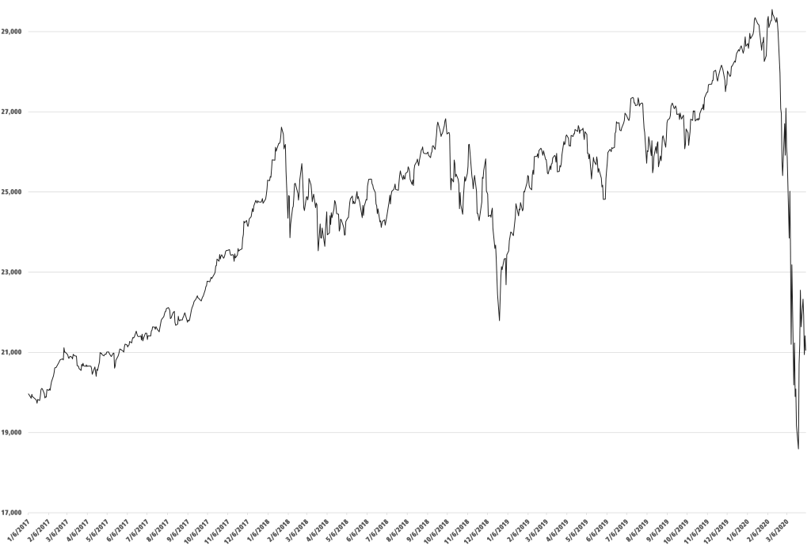
FUT Player Market
Like the stock market player values fluctuate every day based on many factors (player real world performance, in game promotions, etc)
Like stocks, FIFA players are always searching for the optimal time to buy and sell players to maximize profits

Slide 4
Opportunity
There are thousands of players (17,000+) to watch and no easy UI to help track all the players and their values within the game
This shows an urgent need for a system that will let FIFA players look up their favorite players in the database and track smart opportunities to flip players for profit
In comes FUT Stats!

Slide 5
Solution
FUT Stats is a site which will allow FIFA players to watch player value from day to day
Provide simple visualizations to make it easy for players to determine when it is a good time to buy/sell players
Also allow FIFA players to look up players in the database by filtering them by team, nation, position, and other player attributes
By utilizing data scraped from the game we will be able to show players accurate statistics and give them the tools to make informed purchasing decisions!

Slide 6
Goals
The main goal of this project is to organize multiple Kaggle FUT data sets and provide endpoints for a site that will visualize the data for the FIFA players
The visualizations will include player value from day to day and all the 95 players attributes available
The toughest challenge in this project will be mapping all players into a system and providing filtering capabilities to the users

Slide 7
Dataset
https://www.kaggle.com/stefanoleone992/fifa-20-ultimate-team-players-dataset#fut_bin20_players.csv
Example truncated row:
futbin_id | player_name | quality | revision | overall | club | pace | acceleration, | sprint_speed | dribbling
1 | Pelé | Gold - Rare | Icon | 98 | Icons | 95 | 95 | 95 | 96

Slide 8
Limitations
The only limitation is that the data is not the most up to date as it stops in February 2020
However, the project architecture will make it very easy to update the website if a more recent dataset is found or if a dynamic data source is used rather than a flat file.

